Slide 1

Profiling Python code
Pavel Filonov

Slide 2
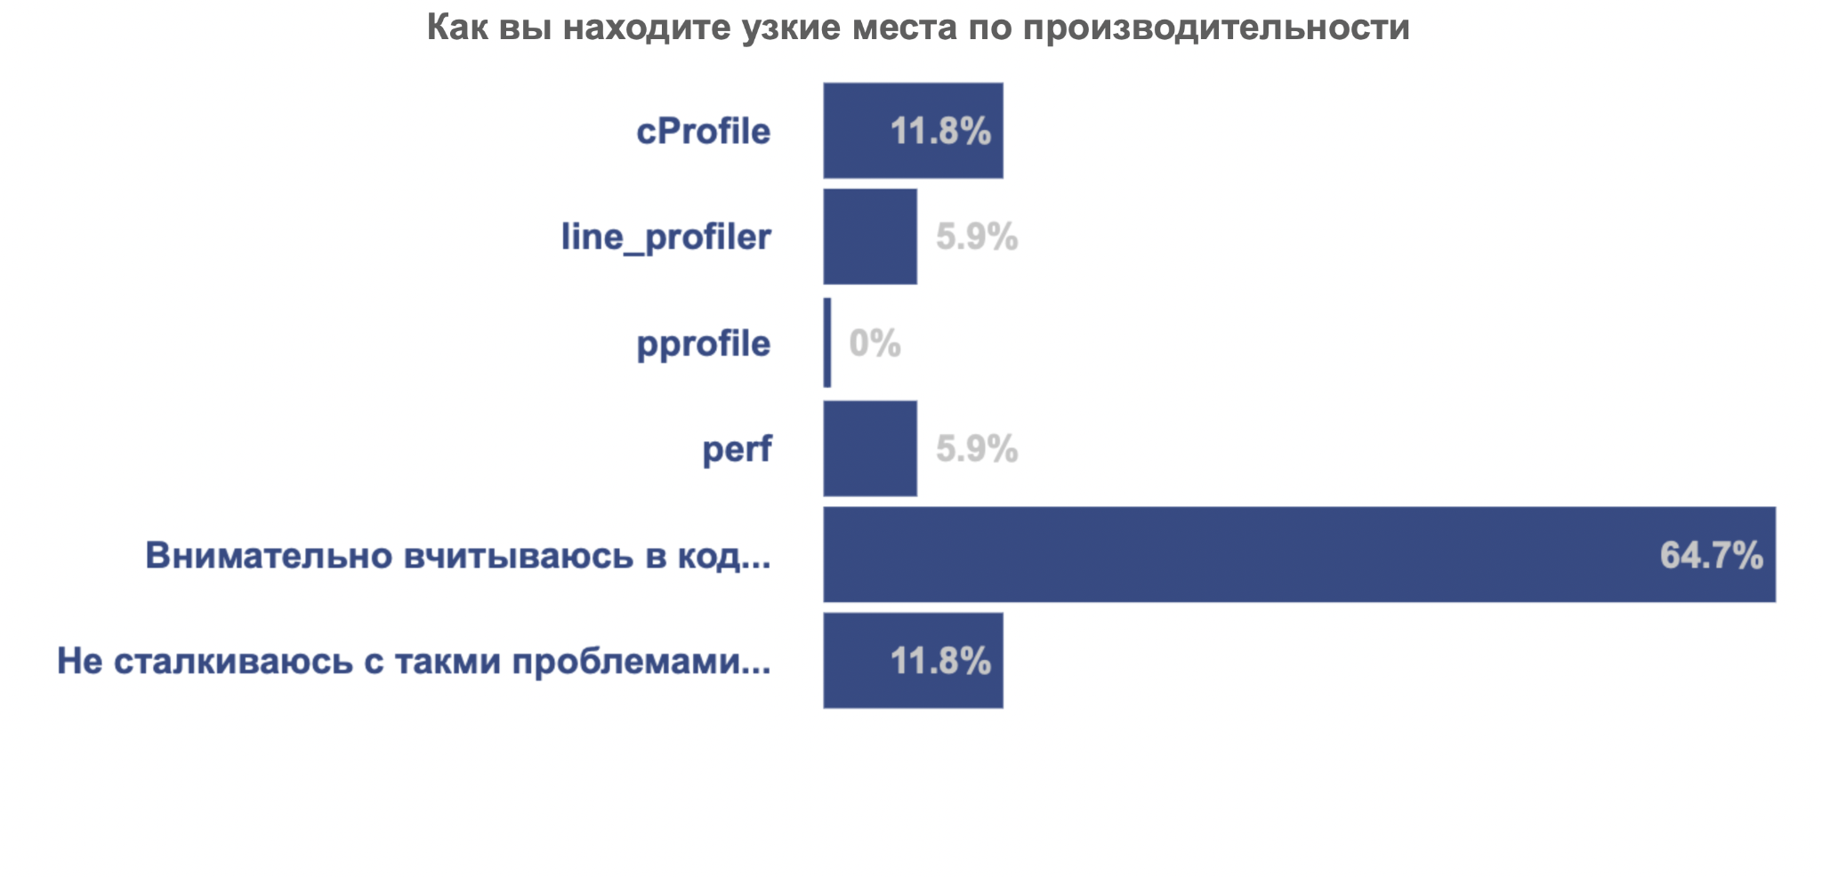
Once upon a time at Python meetup
What do you use to solve performance issues in your code?
Read the code
I have no perf issues

Slide 3

Another poll attempt
What do you use to solve performance issues in your code?

Slide 4
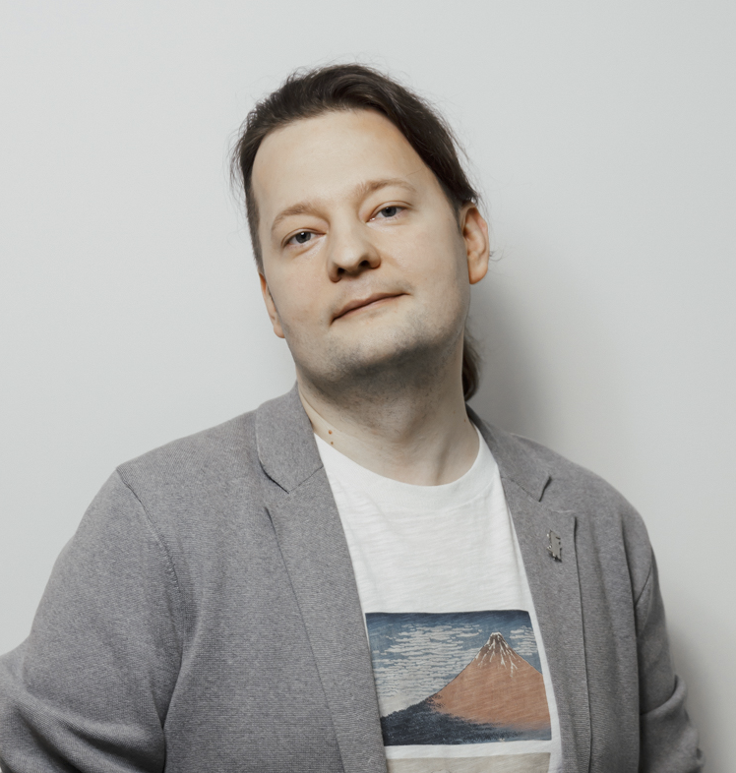
About speaker
DS independent consultant
Former С++ Developer
Favorite python topics:
DS instruments
performance
Interop
tooling
Email: filonovpv@gmail.com
Telegram: @pavel_filonov

Slide 5
Plan
Time | Topic | Tools
13:45 | Measure 7 times | pytest-benchmark, cProfile
12:15 | Between the lines | line_profiler
15:15 | Coffee break | Coffee and Cookies
15:30 | Hungry for RAM | memory_profiler
16:00 | Profiling on the fly | py-spy
16:30 | Conclusion | Reflection and feedback

Slide 6

Link to this slides

Slide 7

Telegram group for communication
go to the workshop chat
ask questions
share your results

Slide 8
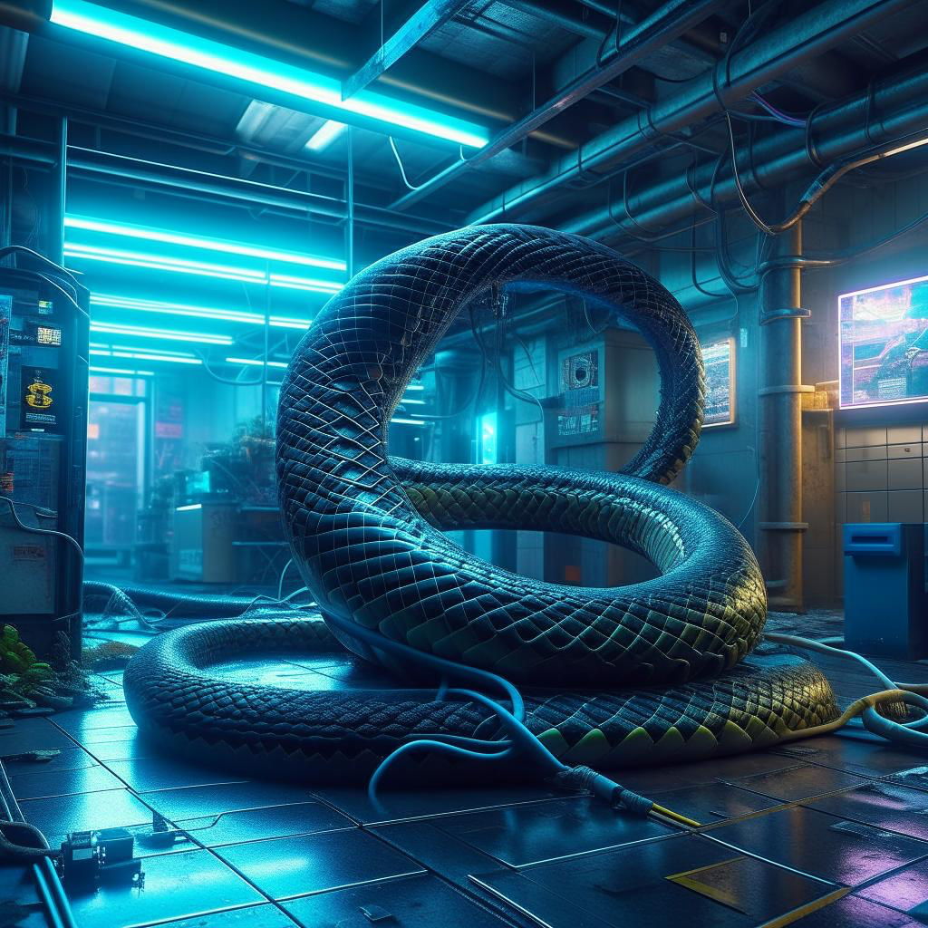
Environment
git clone https://github.com/sdukshis/python-profiling-workshop.git
python3.11 -m venv .venv
source .venv/bin/activate
pip install -U pip
pip install -e .

Slide 9
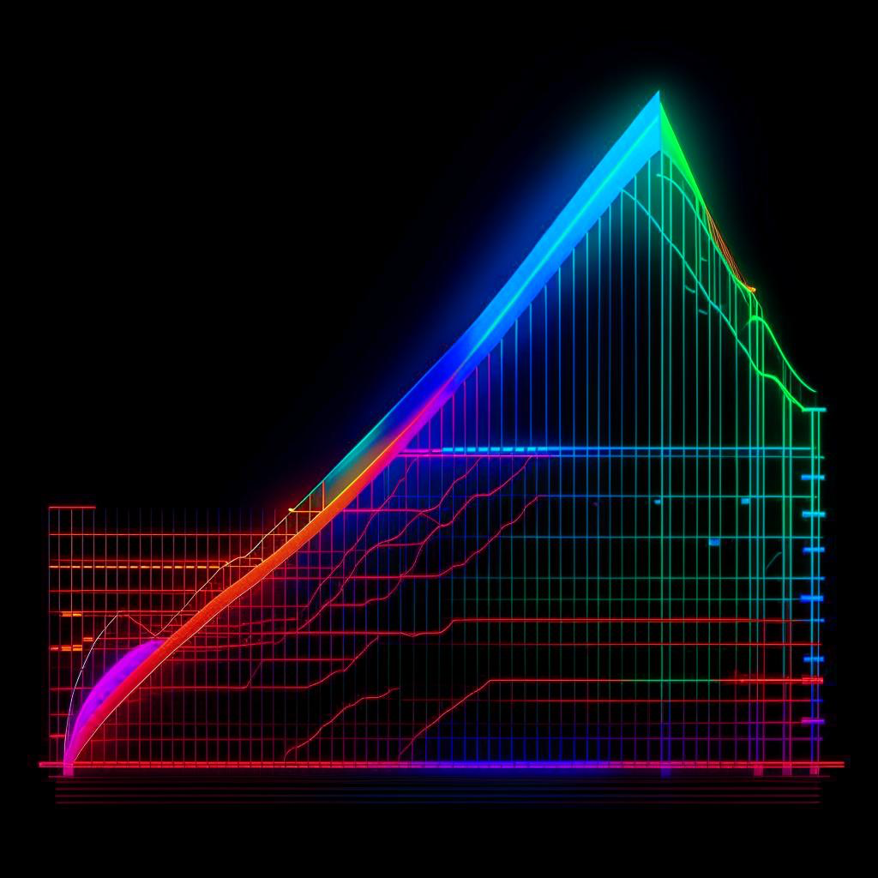
Measure 7 times
what we measure
average
median
minimum
maximum
percentile

Slide 10
Exercise
1. | Run python 01_cprofile/game_of_chance.py 5 times
2. | Estimate the deviation of the average result
3. | Copy all 5 results and the deviation into the chat in one message
Time for exercise: 5 minutes

Slide 11

Such different statistics
max will wobble very often
CPU load
task Manager
accuracy of measurements
Moon phases
mutating neutrinos
...
average is sensitive to max
quantiles and min are more stable

Slide 12
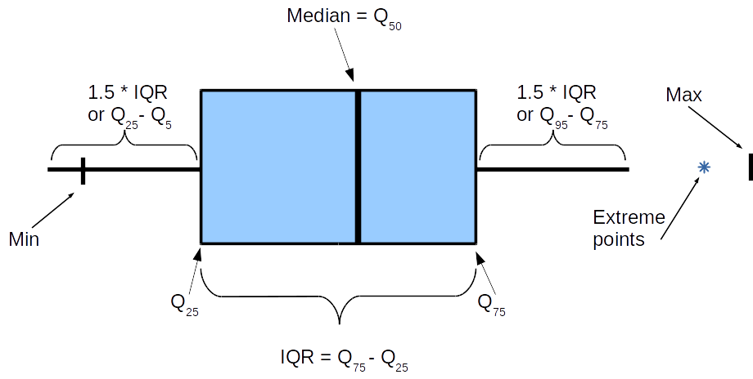
Mustache Box

Slide 13

Microbenchmarks
measure before changes
measure after changes
compare
let's repeat
automate

Slide 14
Exercise
1. | Run 1st pytest --benchmark-autosave 01_cprofile/bench_game_of_chance.py
2. | Try speeding up the play_game code
3. | Run the 2nd benchmark with comparison pytest --benchmark-compare=0001 01_cprofile/bench_game_of_chance.py
4. | Take a screenshot and post it in chat
Time for exercise: 5 minutes

Slide 15

Python in profile or cProfile
with batteries
pstats for analysis
snakeviz for visualization
integration with pytest

Slide 16
Exercise
1. | Measure the time of pytest --benchmark-autosave 01_cprofile/corrector.py
2. | Find the bottleneck using cProfile
3. | Make a change to the code
4. | Measure the time after the change
5. | Take a screenshot of the comparison and send it to the chat
Time for exercise: 10 minutes

Slide 17
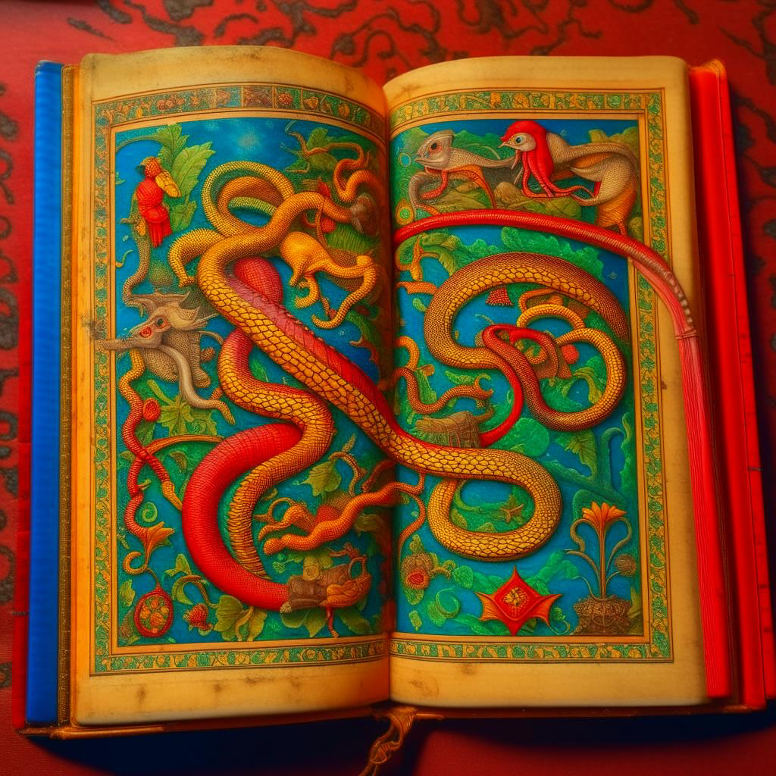
Between the lines
cProfile measures features
line_profiler measures lines

Slide 18
Exercise
1. | Run 1st pytest --benchmark-autosave 02_line_profiler/julia.py
2. | Try speeding up julia's code
3. | Run the 2nd benchmark with comparison pytest --benchmark-compare=0001 02_line_profiler/julia.py
4. | Take a screenshot and post it in chat
Time for exercise: 10 minutes

Slide 19
Exercise
1. | Run kernprof for 02_memory_profiler/SimulatedDataset.py
2. | Building a flamegraph using snakeviz
3. | Find a way to speed up any 1 function
4. | Measure the result and write in the chat was/was for this function
Time for exercise: 10 minutes

Slide 20
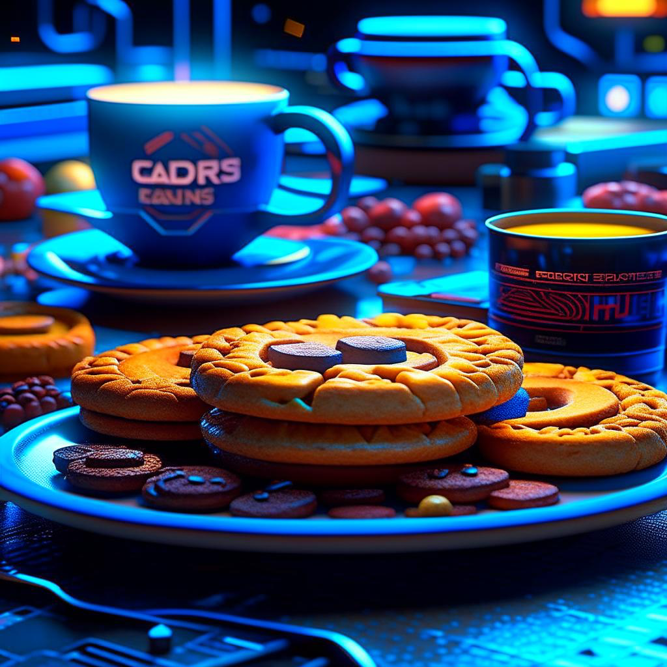
Break
15 minutes

Slide 21
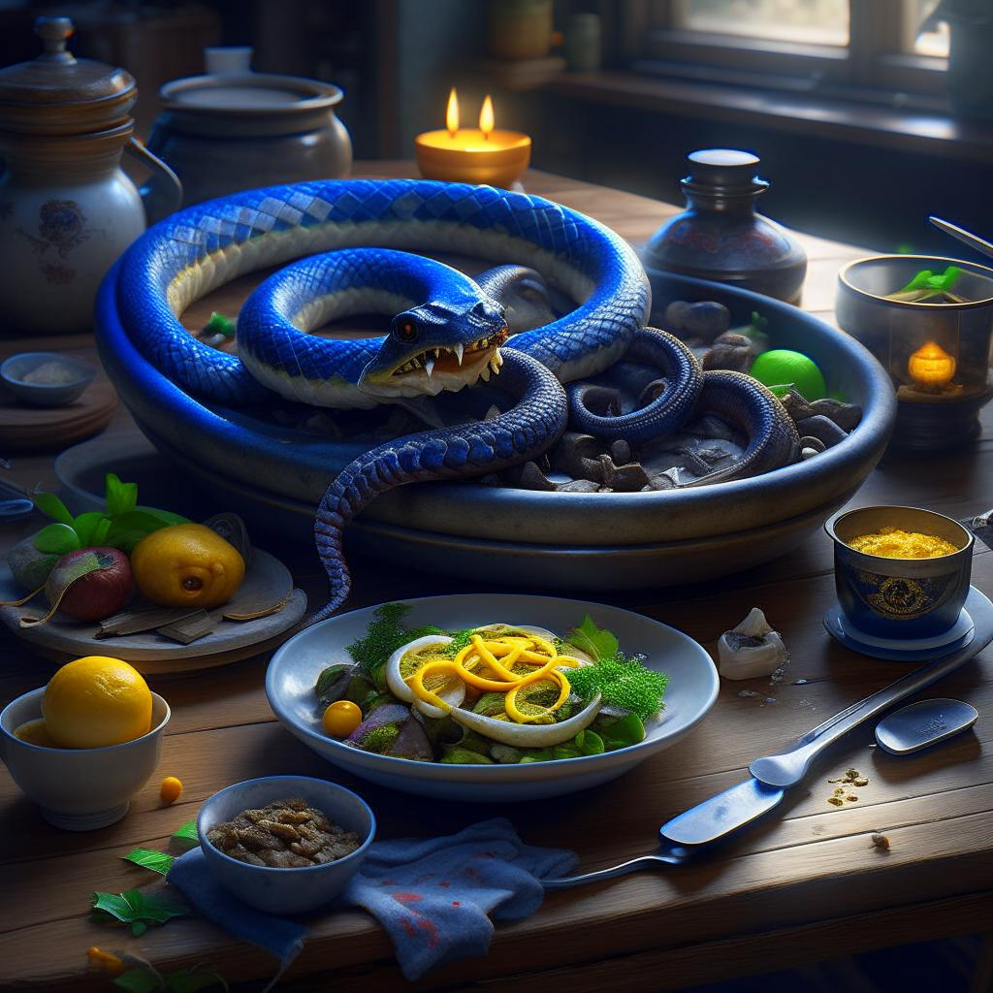
Python is hungry for memory
python not only slow
but also hungry for RAM

Slide 22
memory_profiler
memory consumption graph
display highlighted functions
line-by-line analysis

Slide 23
Practical task
1. | Run memory_profiler for generate_scene1 function from file 03_memory_profiler/shapes.py
2. | Record how much memory was consumed by Points allocation
3. | Think of a way to reduce memory consumption
4. | Measure the result
5. | Write in chat how much Mb you managed to reduce

Slide 24

Profile on the fly
sampling
py-spy
record
top
flamegraphs

Slide 25
Practical task
1. | Run social net client python 04_profile_on_the_fly/social_net.py
2. | Attach with py-spy and collect profile flamegraph
3. | Find out from flamegraph wich of service endpoints is slow

Slide 26

Conclusion

